Slide 1
Digital Portfolio
STUDENT NAME: DIVYA.S
REGISTER NO AND NMID: auttvu352hc24bca018
DEPARTMENT: BCA
COLLEGE: COLLEGE/ UNIVERSITY:HOLY CROSS ARTS AND SCIENCE COLLEGE FOR WOMEN/THIRUVALLUR UNIVERSITY

Slide 2


AGENDA
Problem Statement
Project Overview
End Users
Tools and Technologies
Portfolio design and Layout
Features and Functionality
Results and Screenshots
Conclusion
3/21/2024 Annual Review

Slide 3

PROBLEM STATEMENT Design and implement a responsive web-based student registration form using HTML, CSS, and JavaScript. The form should allow users to enter their details such as name, email, phone number, course selection, and password. JavaScript must be used to validate inputs (e.g., email format, password length, mandatory fields). The interface should be styled with CSS to make it user-friendly and visually appealing. Requirements: Use HTML for structure (form, labels, inputs, buttons). Use CSS for layout, colors, fonts, and responsiveness. Use JavaScript for form validation (e.g., check if fields are empty, validate email, match password and confirm password). Provide meaningful error messages if validation fails. Display a success message after successful form submission. Expected Output: A functional and styled registration form that prevents invalid submissions and ensures good user experience.

Slide 4

PROJECT OVERVIEw
This project focuses on building a Student Registration Form using HTML, CSS, and JavaScript. The main goal is to create a simple, interactive, and responsive web page where students can input their details and register successfully.
HTML is used to design the structure of the form, including input fields (name, email, phone, password, etc.) and buttons.
CSS ensures that the form is styled professionally, with proper layout, colors, fonts, and responsiveness for different screen sizes.
JavaScript adds functionality by validating user inputs (e.g., checking if the email is in correct format, ensuring that the password meets the required length, and confirming that no field is left empty).
This project demonstrates how frontend web technologies work together to build user-friendly applications. It highlights real-world practices such as form handling, client-side validation, and responsive design.

Slide 5

WHO ARE THE END USERS?
Students – who will use the registration form to enter their personal details and register for a course/program.
Administrators / Institution Staff – who will receive the submitted details and use them for maintaining student records.
General Users (Visitors) – anyone accessing the website who may test the form or explore its features.

Slide 6

TOOLS AND TECHNIQUES
HTML5 – for creating the structure of the web pages and form elements.
CSS3 – for styling, layout, responsiveness, and improving the user interface.
JavaScript (ES6) – for client-side scripting and form validation.

Slide 7
POTFOLIO DESIGN AND LAYOUT
The Student Registration Form was designed with a clean and minimal layout using HTML5, CSS3, and JavaScript.
The layout is responsive, ensuring it adapts to different screen sizes (desktop, tablet, and mobile).
The form is centered on the screen with proper spacing and alignment for a professional look.
A card-style design is used with rounded corners (border-radius), shadows (box-shadow), and padding for neat appearance.
Input fields have uniform width and styling with smooth borders for consistency.
Buttons are styled with hover effects to enhance interactivity.
⚡ Features of the Project
User-Friendly Form – Students can easily enter their name, email, and password.
Input Validation –
Ensures that no field is left empty.
Validates correct email format.
Checks password length (minimum 6 characters).
Verifies password confirmation matches.
Interactive Messages –
Shows error messages in red for invalid input.
Shows success messages in green after successful registration.
Reset Option – Allows users to clear all inputs quickly.
Responsive Design – The form remains usable and visually appealing across different devices.
Modern UI Elements – Rounded corners, hover animations, and a soft background improve user experience.
7

Slide 8
FEATURES AND FUNCTIONALITY
🔹 Features
Simple User Interface – Clean, minimal form design for easy use.
Responsive Layout – Works on desktop, tablet, and mobile devices.
Input Validation
Interactive Feedback – Shows success or error messages dynamically without refreshing the page.
Reset Option – Users can clear the form instantly.
Modern Styling – Hover effects, rounded input fields, shadows, and smooth design improve user experience.
functionality
Form Input Handling: Users enter Name, Email, Password, and Confirm Password.
Validation with JavaScript:
If fields are empty → error message.
If email format is wrong → error message.
If password is too short or mismatched → error message.
If everything is correct → success message.
Dynamic DOM Updates: Messages appear directly below the form without page reload.
Reset Button: Clears all fields and messages with one click.

Slide 9
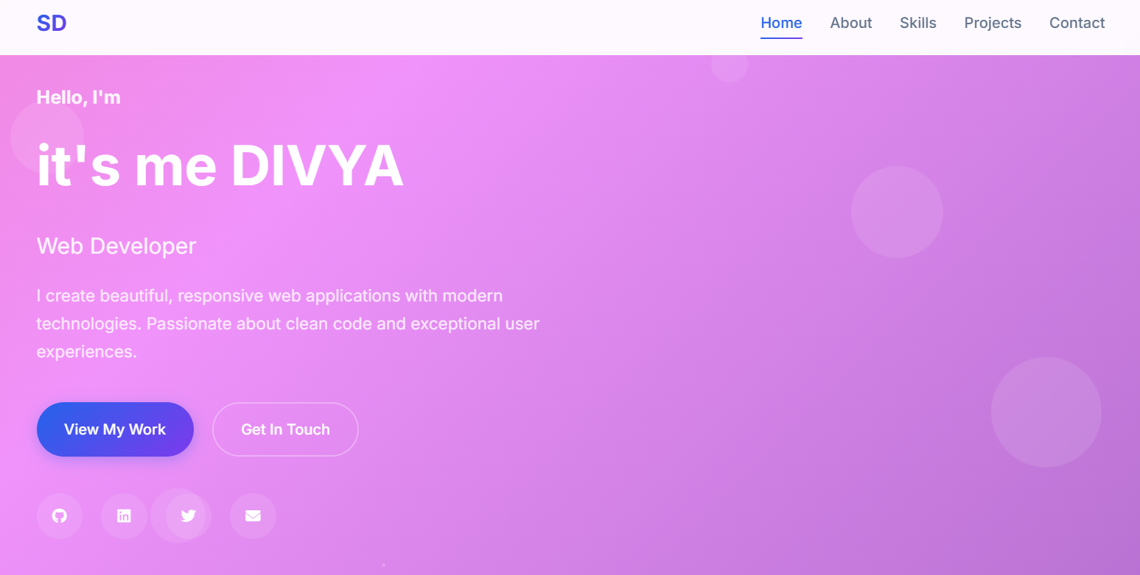

RESULTS AND SCREENSHOTS
3/21/2024 Annual Review
9

Slide 10
CONCLUSION
The Student Registration Form project successfully demonstrates the use of HTML, CSS, and JavaScript in creating a responsive and interactive web application. The form provides a clean design, validates user input, and gives real-time feedback to ensure data accuracy. With features like password confirmation, email validation, and reset options, it improves both usability and user experience.
This project highlights essential frontend web development skills, including form handling, DOM manipulation, validation, and responsive UI design.
10

